Slide 1
Mitron Bank Analysis
Problem Statement:
Mitron Bank is a legacy financial institution headquartered in Hyderabad. They want to introduce a new line of credit cards, aiming to broaden its product offerings and reach in the financial market. So, they need a data analyst team to help them find insights from their customers data which will help them in launching the new credit cards.
However, the strategy director of Mitron Bank is skeptical and asked them to do a pilot project with the sample data before handing over them the full project.
We have to analyse the provided sample data and report key findings to the strategy team of Mitron Bank. This analysis is expected to guide them in tailoring the credit cards to customer needs and market trends.

Slide 2
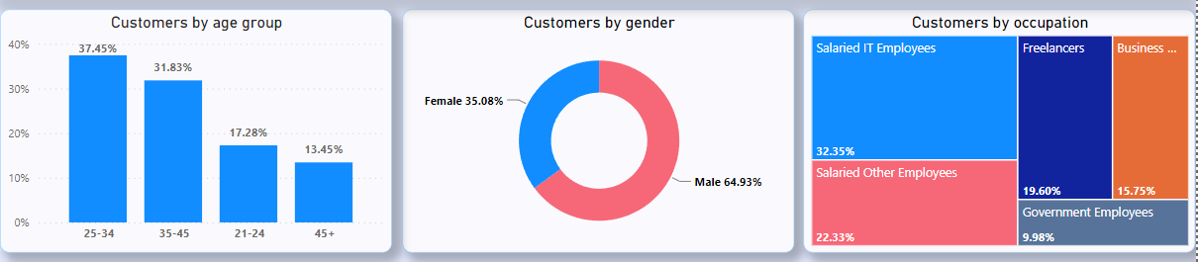
Demographic classification
Classify the customers based on available demography such as age group, gender, occupation etc. and provide insights based on them.
70% of the customers are in the age groups of 25-34 and 35-45 years.
64% are Male customers.
54% of the customers are in employees in IT and other Salaried sectors.
So, the preferred target should be these to reach more people efficiently. Later we can expand to remaining categories of customers

Slide 3
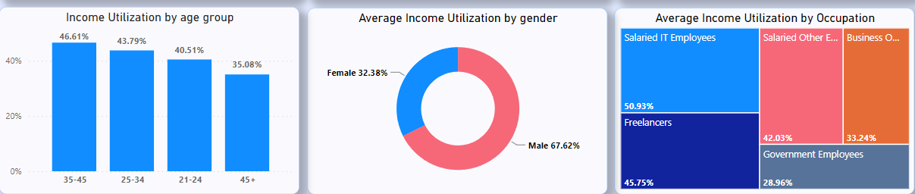
Income utilization %
Find the monthly income utilization % of customers (avg_spends/avg_income). This will be your key metric. The higher the income utilization %, the more is their likelihood to use credit cards.
Customers with income utilization more than 40% are in the age groups of 25-34, 35-45 and 21-24 years.
Male customers are spending more with income utilization of 67%.
Customers whose income utilization more than 40% are in employees in IT, Freelancing and Other Salaried sectors
So, the preferred target should be these to reach more people efficiently. Later we can expand to remaining categories of customers

Slide 4
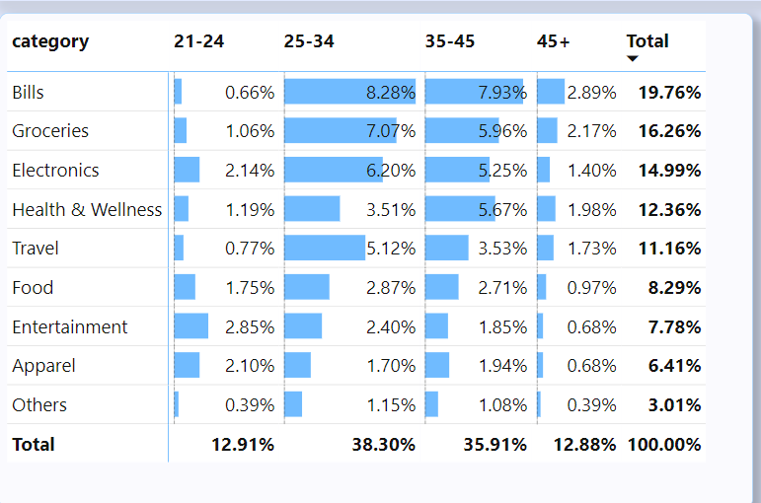
Spending Insights
Where do people spend money the most? Does it have any impact due to occupation, gender, city, age etc.?
This can help you to add relevant credit card features for specific target groups.
Top 5 categories where customers are spending their money:
Bill’s
Groceries
Electronics
Health & Wellness
Travel
We should introduce relevant features for credit card like cashback, coupon’s, discount, etc. which are targeted at these segments. So, the adoption for credit card increases.

Slide 5
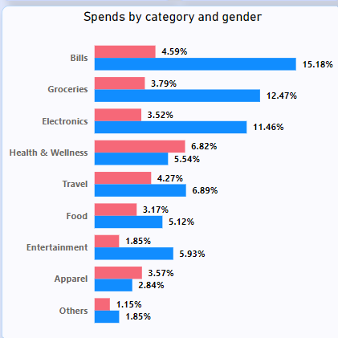
Spending Insights
Where do people spend money the most? Does it have any impact due to occupation, gender, city, age etc.?
This can help you to add relevant credit card features for specific target groups.
Among top 5 categories the targeted customers should be:
Bill’s -Male
Groceries -Male
Electronics -Male
Health & Wellness -Female
Travel -Male
This is because from the analysis we can see that in
Health & Wellness segment females are spending more than males

Slide 6
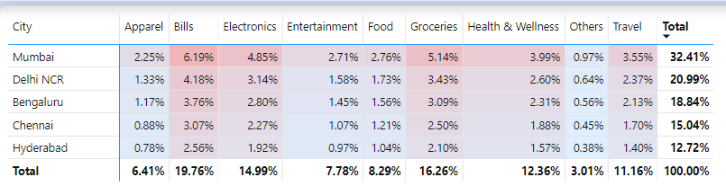
Spending Insights
Where do people spend money the most? Does it have any impact due to occupation, gender, city, age etc.?
This can help you to add relevant credit card features for specific target groups.
If we look at city wise Mumbai and Delhi NCR are at the top.
Since the most spending is happening in these cities. The customers would be most likely to use credit cards. We can do trials by introducing credit card in these cities.

Slide 7
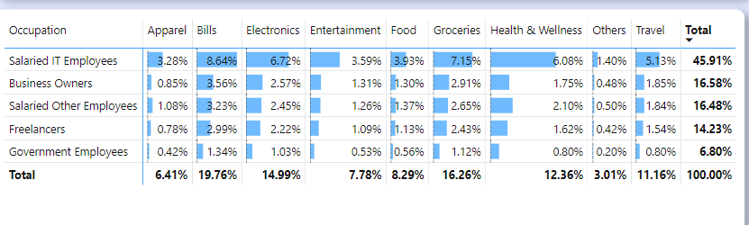
Spending Insights
Where do people spend money the most? Does it have any impact due to occupation, gender, city, age etc.?
This can help you to add relevant credit card features for specific target groups.
Here we can observe salaried IT employees are on top in spendings in every category.
These customers would be most likely to use credit cards. We can introduce features or give offers to IT employees in every product category.

Slide 8
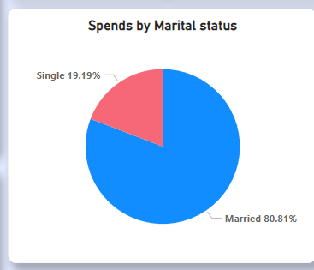
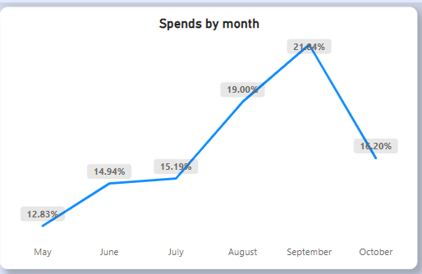
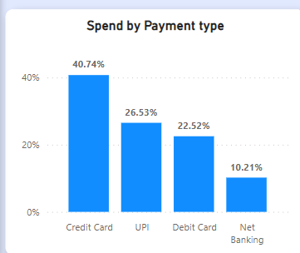
Spending Insights
Married people are spending more.
People are spending more in months of August and September.
Top used payment type is credit cards with over 40% share.
By above insights:
we should offer credit cards mainly to married people since they are spending more and would need credit card.
We can give special offers in peak spending months like August and September. But we don’t have enough data to identify these patterns occur repeatedly or not.
Since credit card is the most used payment type, we can attract more customers if we provide them better benefits than competitors.

Slide 9
Recommendations
For Broader market:
Rewards on High Spend Categories: Top customer segment spends the most on bills, groceries, and electronics. Offering cashback or rewards points on these categories would likely encourage more spending on the credit card.
Bundled Services: Bundled offers for spending across multiple categories could incentivize broader usage of the credit card.
Financial Management Tools: Integrating tools that help customers track and manage their spending can add value to the credit card, encouraging its use as a primary method of payment.
Flexible Payment Options: Features like EMI payments or flexible due dates can appeal to customers who prioritize payment flexibility.
Seasonal Offers (Consider only after analysing data of longer time period): Credit card features could include special discounts or higher rewards points during peak spending months to capitalize on these trends.

Slide 10
Recommendations
For Specific Individual:
Health & Wellness Benefits: Secondary research indicates a growing trend in health and wellness spending. Including benefits such as discounts on gym memberships or wellness apps could be attractive.
Travel Perks: For customers who spend on travel, offering travel-related benefits such as lounge access, travel insurance, or no foreign transaction fees could be a strong incentive.
Entertainment Access: Early access or discounts on entertainment could be a draw for customers who spend in this category.
Additional(to have an edge over competition):
Security Features: Enhanced security features like virtual card numbers for online shopping can provide peace of mind, which is a significant factor in choosing a credit card.
Customizable Rewards: Given the diversity in spending even within the top customer segment, a feature that allows customers to choose their own rewards categories could cater to individual preferences, increasing card usage.

